Slide 1
A Guide to Analog Skating Force
July 19, 2020

Slide 2
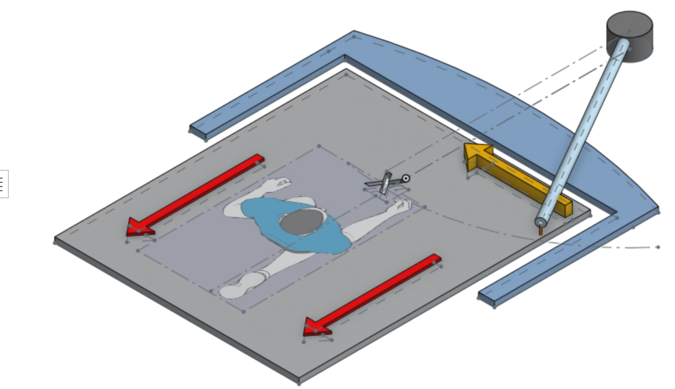
A pendulum will come to rest at the lowest point in its swing path and the tonearm acts similarly. The red arrows represent the direction of friction. The yellow arrow represents the skating motion of the arm.
The treadmill moves and creates friction at the stylus causing the tonearm to swing to the lowest point in its arc of travel – where the “X” is. At that point, the arm will no longer move.
© WallyTools |WAM Engineering

Slide 3
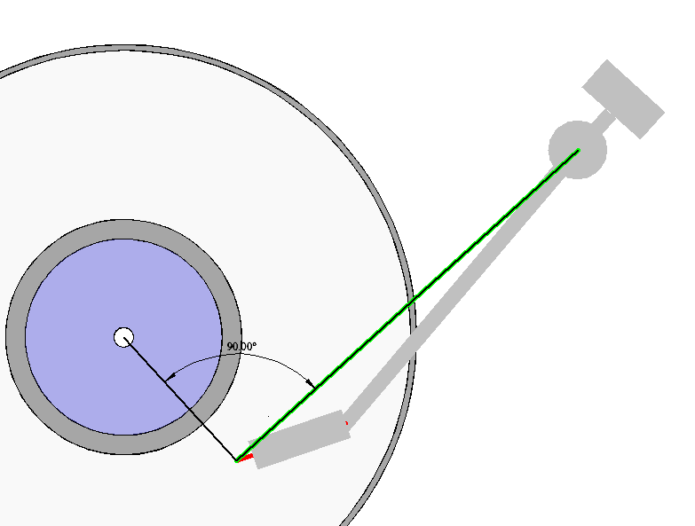
With NO overhang implemented in the setup of the turntable/ tonearm/cartridge relationship, the line formed by the Stylus to Pivot is at a perfect tangent to the groove radius.
At this point there is NO SKATING FORCE exerted on the stylus
© WallyTools |WAM Engineering
Note that the offset angle of the tonearm/cantilever is irrelevant to the development of skating force

Slide 4
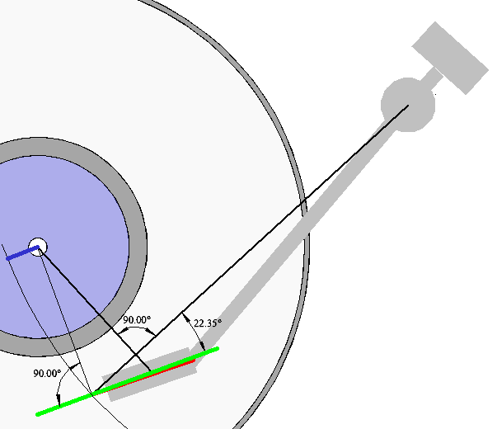
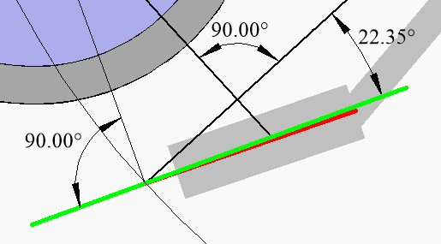
As an overhang is introduced (represented by the blue line) it causes the groove tangent at the point of the stylus location (represented by the green line) to be at an angle to the line formed by the Stylus to Pivot (black line). This angle (22.65 degrees in this example) causes another skating force.
Just imagine that the green line is pushing on the stylus because it is at an angle to the moving mass (black line).
© WallyTools |WAM Engineering

Slide 5
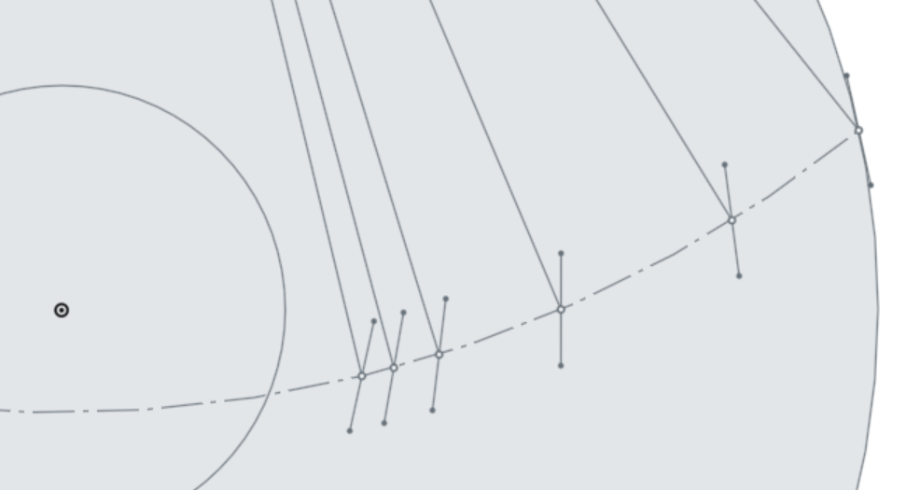
Effective Length and Groove Aspect Angle
Where the effective length meets the groove, it does so at an angle to the groove. This angle has the effect of driving the stylus inward. This effect is NOT the result of the outer groove wall pushing on the stylus. It is a product of the direction of travel of that portion of the record that lies directly underneath the stylus – which, of course, is a product of that radius.
Notice that the angles – and resultant skating forces – are highest at the outer edge of the record, dropping near the middle of the record and then increasing again at the inner grooves.
RADIUS | RADIUS NOTE | GROOVE VS EFF LEN
146mm | Max. Angular Error (+) | 26.1°
120.9mm | Outer Null Point | 24.2°
89.3mm | Max. Angular Error (-) | 23.1°
68mm | Inner Null Point | 24°
60.3mm | IEC Innermost Groove | 25°
55mm | Min. Innermost Groove Measured by WAM Engineering (VERY rare) | 26°
© WallyTools |WAM Engineering

Slide 6
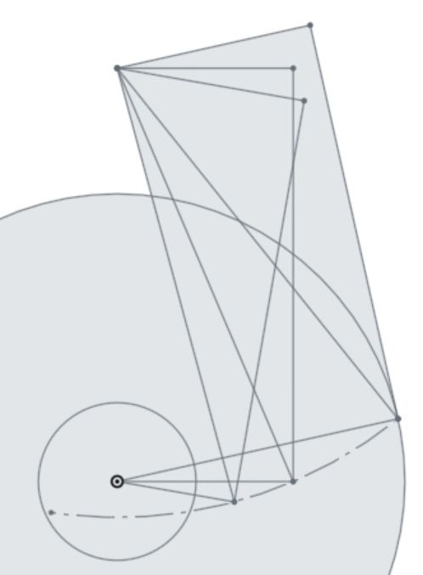
Effective Moment Arm
90° Angles
The geometric function that causes skating is called the Effective Moment Arm (EMA).
EMA length varies depending upon the distance of the stylus from the center of the record. The longer the EMA, the greater the skating force.
Notice the EMA corresponding with the center of the record groove is less than EMA at the record extremes. This is consistent with the table in the previous slide.
As effective length of the arm increases, the EMA does not change, but the ratio between EMA and the effective length changes and thereby results in a decrease in skating force in longer arms relative to shorter arms.
Effective Length
Groove Radius
© WallyTools |WAM Engineering
90° Angles

